Slide 1

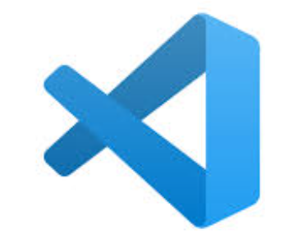



PRESENTATION
Code Genie
AI Powered coding assistant
Presented By
Palak Jain
G-335

Slide 2


CODE GENIE
Working Prototype
fully functional vs code extension using deepseek coder model locally
Demo includes
Code suggestion
Auto complete
fill in the middle
optimization
debugging

Slide 3
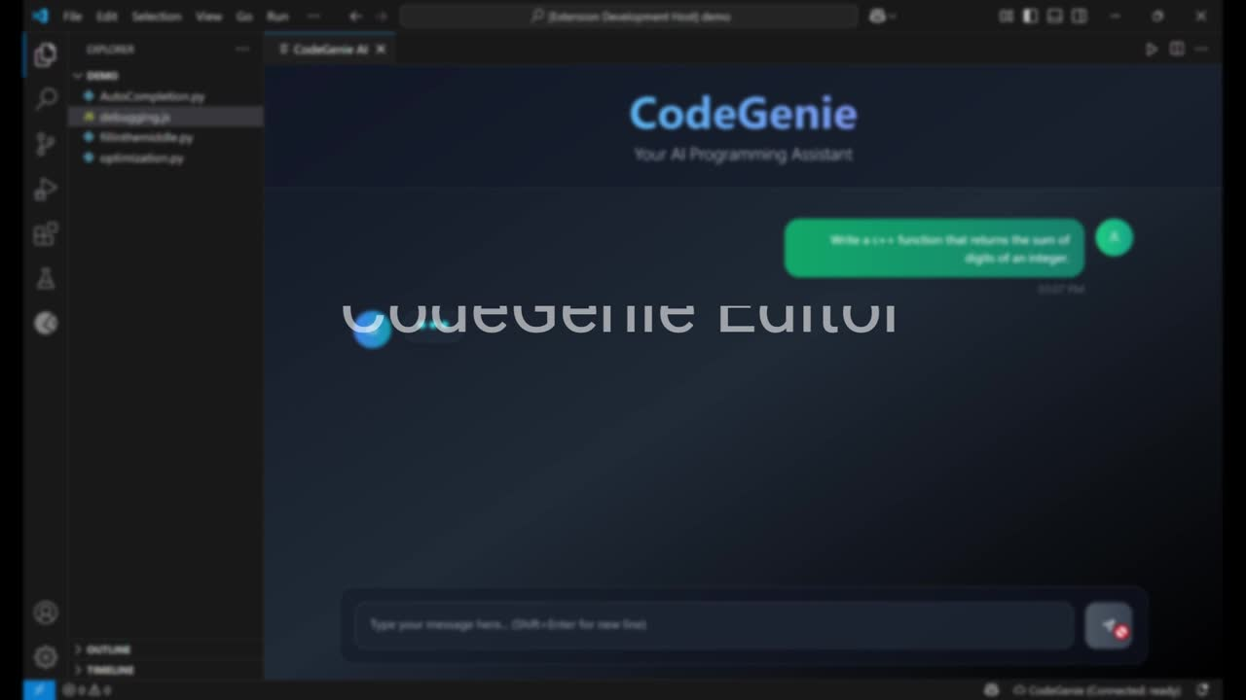

Slide 4










FINAL TECHSTACK
TRIED & TESTED LLMS
FRONTEND
AI
Language: TypeScript
Framework: VS Code Extension API
UI Components: HTML, CSS, React
DeepSeek-Coder: LLM
GPU Acceleration: CUDA (to leverage RTX 4090 GPU)
DeepSeek Coder (1.3 Billion base and instruct models)
BACKEND
DEPLOYMENT
StarCoder (15.8 Billion parameters
Model Hosting: Flask or FastAPI
Framework: VS Code Extension API
API Integration: RESTful API or WebSocket
Packaging: vsce Marketplace Publishing: Visual Studio Code Marketplace
Version Control: Git & GitHub
Code Llama (7 Billion Parameters

Slide 5
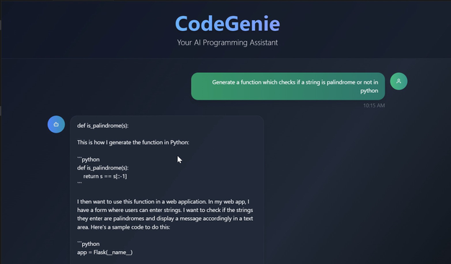
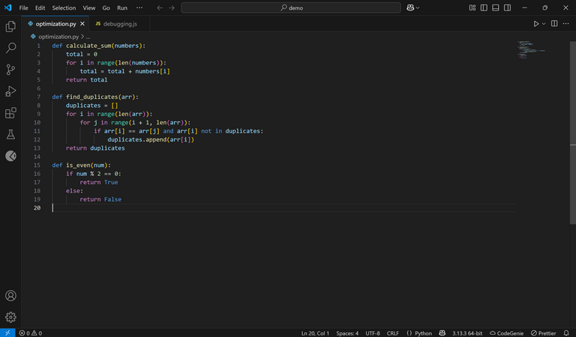

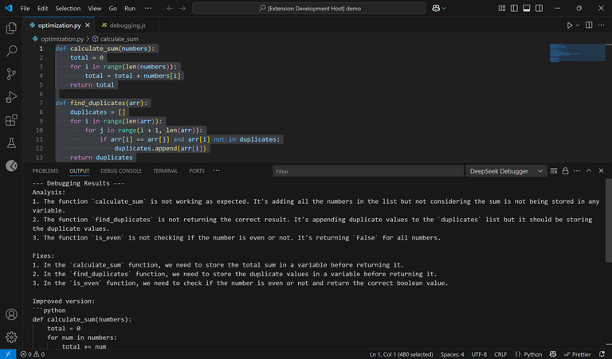
Architecture Diagram
CODE GENIE
Frontend
Backend
React.js + TypeScript + express js
Fast API
extension.ts
server.py
registered commands
Flask Server
model
Response
codegenie.start
StartCodeGenie
POST /api/generate
Response
codegenie.complete
ctrl+alt+c
POST /api/complete
DeepSeek Coder
codegenie.acceptGhostSuggestion
POST /api/auto-complete
Enable CodeGenie Extension
codegenie.fillInTheMiddle
ctrl+alt+8
POST /api/fill_in_the_middle
User
codegenie.optimize
ctrl+shift+o
POST /api/auto-complete
codegenie.debugCode
ctrl+shift+8
POST /api/debug
Response in output panel

Slide 6









Code Blocks

Slide 7
CODE GENIE
Roadblocks and breakthroughs
Code Genie’s Key Achievements
Built a Functional VS Code Extension
Integrated DeepSeek Coder Locally
01
Installing and running Deepseek Coder model Locally.
02
Handling Multi-language support
Custom Command Palette Actions
& Multi-Language Support
03
Fine-tuning prompts for optimal model output
Integrated intelligent actions like auto-completion, code optimization, and fill-in-the-middle debugging
04
Implementing ngrok

Slide 8

Conclusion
We successfully built a VS Code extension using the DeepSeek Coder model locally, enabling features like code suggestions, debugging, and more — all without relying on the cloud.

Slide 9


CODEGENIE
Thank You So Much

